Slide 1

AI based smart career counselling
An Overview

Slide 2
Problem Description
Ministry: Ministry of Education
PS Code: SIH1434 Problem Statement: Making career choices and AI based counselling accessible to every child at secondary level along with aptitude tests and detailed career paths. Team Name: EdXperts
Team Leader: Vijesh Pethuram K
Institute Code(AISHE): 1-3516234145
Institute Name: Mepco Schlenk Engineering College
Theme: Education

Slide 3
Team Members Details
Team Member Name | Branch | Stream
Vijesh Pethuram K (Leader) | Bachelor Of Technology | Information Technology
Prabhu R | Bachelor Of Technology | Information Technology
Vignesh S | Bachelor Of Technology | Information Technology
Sanchith R S | Bachelor Of Technology | Information Technology
Abinaya S M | Bachelor Of Technology | Information Technology
Deepalakshmi N J S | Bachelor Of Technology | Information Technology
Team Mentor Name | Category | Expertise Domain | Domain Experience
Dr.G.Yogarajan | Academic | Networking | 18 years

Slide 4
Proposed Ideas
To Recommend a suitable career for the students based on Aptitude Tests and previous marks.
The student will then be allowed to chat with a Chatbot through which his careers are predicted and refined.
It is planned to have real-time career insights and providing career suggestions based on it.
Speech-to-text is used for people with disabilities to access the application and Text-to-speech is used to access the application in audio format.

Slide 5


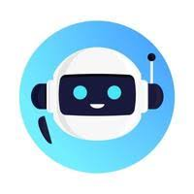

Use cases
Students will receive a report that explains their aptitude test results and provides suggestions for careers that are a good fit for them.
Real time career insights and providing career suggestions based on it.
The student then chats with a chatbot to discuss their results and explore different career options.
The student uses the information to make their career choices and make a decision about their future.

Slide 6
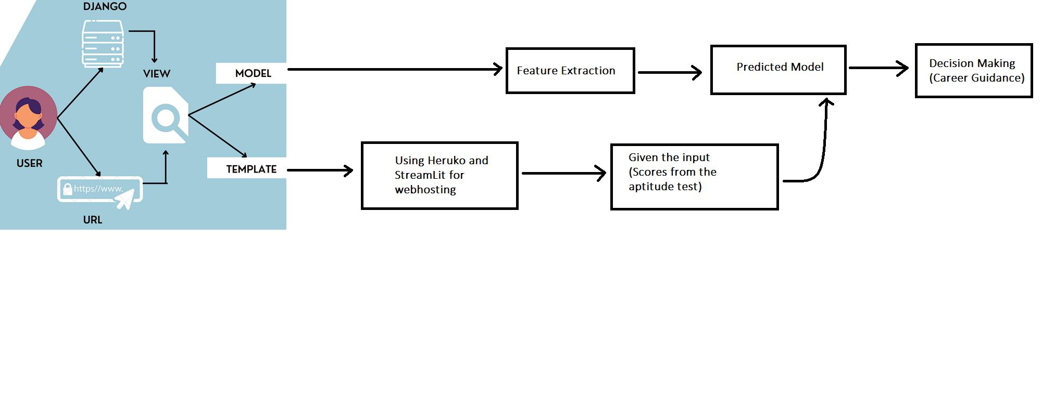
System Design - Frontend

Slide 7
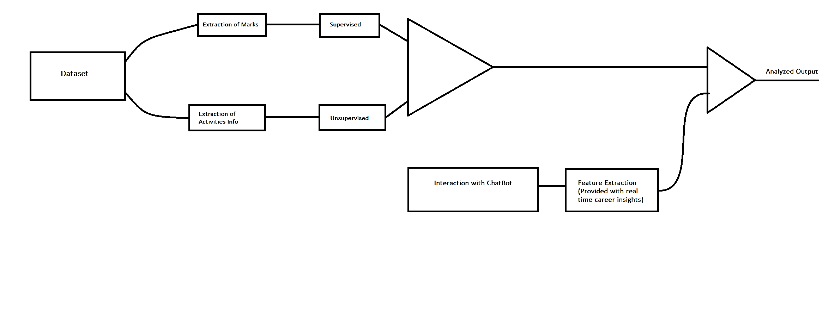
System Design - Backend

Slide 8
System Design (contd.)
As from the given criteria, we are going to implement the model as web application.
Django and Humalect is considered to implement the model for web application.
REST Framework is a flexible toolkit for building Web APIs which can be used to machine learning model deployment by calling an API endpoint.

Slide 9
System Design (contd.)
As we are analyzing their career based on their marks in aptitude tests and previous marks, we are going to to implement them by classification through supervised learning.
For the other miscellaneous activities like hobbies and area of interest, we are going to implement through clustering through unsupervised learning.
This results will be further processed and analysed and followed by the student will be interacted with Chatbot.

Slide 10
System Design (contd.)
The scores will be calculated and it is analyzed by the trained model, the further career guidance will be taken.
The front end development is to be made using StreamLit and Humalect.
The prototype model is a good starting point for out model. It is able to achieve a high classification accuracy and it is relatively considered easy to implement.
The prototype model can be improved by using a larger dataset of labelled career choice.

Slide 11
Technologies and Dependencies
Machine Learning and Data Analytics:
Machine learning libraries and frameworks like TensorFlow, PyTorch, or scikit-learn for building recommendation models.
Data analytics tools to process and analyze user data, such as Python's pandas and NumPy libraries.
Natural Language Processing (NLP):
NLP libraries and frameworks, like NLTK, or Hugging Face Transformers, for text analysis and understanding user input.
Pretrained language models for text generation, sentiment analysis, and entity recognition.

Slide 12
Technologies and Dependencies (contd.)
Hugging Face Transformers:
Hugging Face's Transformers library is a state-of-the-art resource for working with transformer-based NLP models like BERT, GPT-2, and RoBERTa.
It offers pre-trained models, fine-tuning capabilities, and easy integration with popular deep learning frameworks.
Web Development:
Front-end web development technologies (HTML, CSS, JavaScript) for creating the user interface of the web app.
Back-end development technologies (e.g., Node.js, Python, Ruby on Rails) for server-side logic and API development.

Slide 13
Thank You

